Slide 2
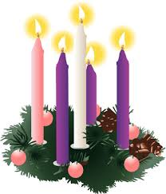
THE FOUR SUNDAYS OF THE ADVENT SEASON

Slide 3



Slide 4
1. WHAT HAPPENS WHEN LIFE CAVES IN?
Matthew 1:18
This is how the birth of Jesus Christ came about: His mother Mary was pledged to be married to Joseph, but before they came together, she was found to be with child through the Holy Spirit.

Slide 5
II. Joseph is wanting to do the right thing.
Matthew 1:19
Because Joseph her husband was a righteous man and did not want to expose her to public disgrace, he had in mind to divorce her quietly.

Slide 6
III. Joseph listens to the dreams of God.
Matthew 1:20-23
An angel of the Lord appeared to him in a dream and said, "Joseph son of David, do not be afraid to take Mary home as your wife, because what is conceived in her is from the Holy Spirit. She will give birth to a son, and you are to give him the name Jesus, because he will save his people from their sins."

Slide 7
IV. Joseph wakes up and decides what to do.
Matthew 1:24-25
When Joseph woke up, he did what the angel of the Lord had commanded him and took Mary home as his wife. Joseph had no union with Mary until she gave birth to a son. And he gave him the name Jesus.

Slide 8

CHRISTMASIS ALL ABOUT PEACE

